Slide 1
Using a catalog and assist.org to write a two-year Ed Plan
The college catalog is the road-map between the college and the student.
As long as you maintain continuous enrollment, the catalog or any later edition can be used to satisfy course requirements.

Slide 2
Assume you want to earn a BS degree in Civil Engineering from San Jose State
Develop a plan based on information in catalog.
Compare against www.assist.org
Compare against what faculty, dept., and engineering counselors tell you.
Compare against what your friends tell you.
Keep written records.

Slide 3
Civil Engineering Dept. - Pg. 137
Prep for Major:
Math 30, Math 31, Math 32, Math 133A, Phys 70, Phys 71, Chem 1A, Math 129A
Engineering Common Area:
CE 099, CE 112, CE113, EE 098, ENGR 010, CE 020, MATE 025, ME101 (Dynamics), & ME 111
Any course with a number < 100 is lower division and may be available at a community college.
Some upper division courses also may be available at the community college.

Slide 4
Other requirements
American Institutions – 6 units
Physical Education – 2 units
GE requirements ← consult major advisor at SJSU.
Required lower division courses in CE
Required upper division courses in CE

Slide 5
Lower Division major Requirements:
Math 30, Math 31, Math 32, Phys 70, Phys 71, Chem 1A
CE 008, CE 099, EE 098, ENGR 010, CE 020, MATE 025

Slide 6
Math Courses – Pg 319
Math 30 – Calculus 1
Math 31 – Calculus II
Math 32 – Calculus III
Math 133A – Differential Equations ←MC has
Math 129A – Linear Algebra ← MC has

Slide 7
Physics Courses– Pg 377
Phys 70 - Mechanics
Phys 71 – Electricity and Magnetism

Slide 8
Engineering Courses: CE Pg 138 EE Pg 198 ENGR Pg 233 (General Engineering) MATE Pg 123
CE 008 – Surveying
CE 020 – Graphics, CAD, and Programming
CE 099 - Statics
EE 98 – Circuits
ENGR 010 – Introduction to Engineering
MATE 025 – Introduction to Materials

Slide 9
Non-science GE requirements Pg 204
Science GE – you will satisfy this requirement with your major classes.
Non-Science GE:
HUM 1A/1B and HUM 2A/2B (24 units)
Or
AMS 1A/1B, ENGL 1A, ENGL 1B, Oral Communications, Human Understanding

Slide 10
What does assist.org say?

Slide 11
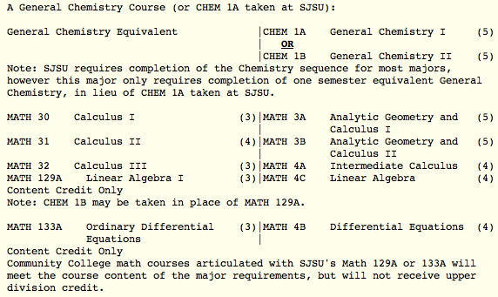

Slide 12
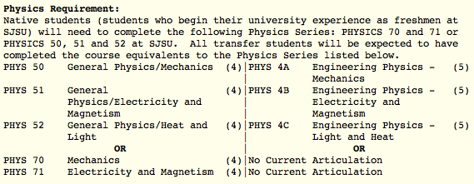

Slide 13
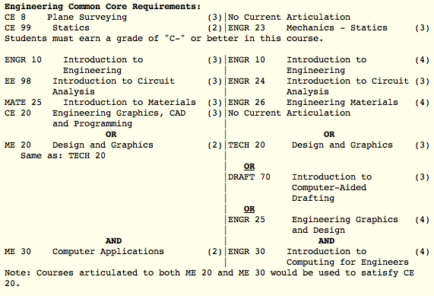

Slide 14
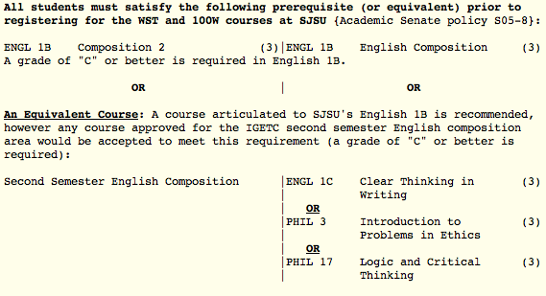

Slide 16
Write a two-year Ed Plan for an engineering major with transfer to a 4-year university.

